Slide 1
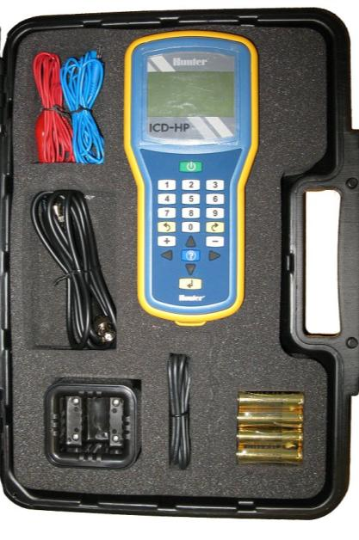
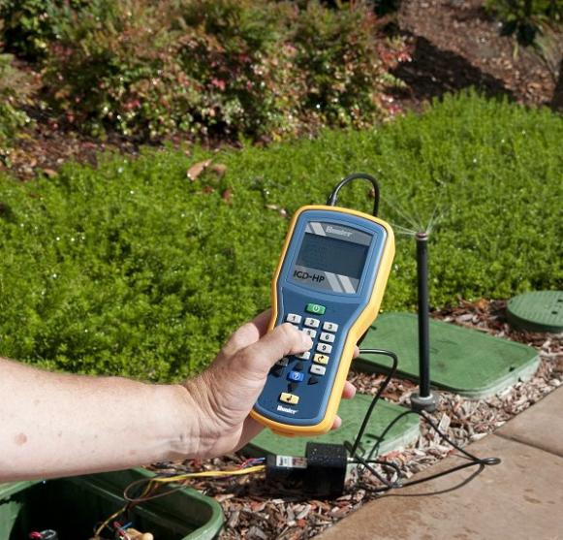
Hunter ICD-HP
Decoder Handheld Programmer
David Danley

Slide 2
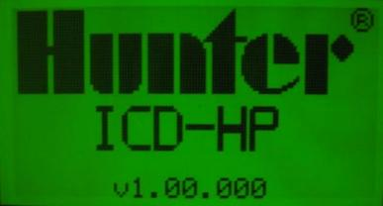
ICD Handheld Programmer

Slide 3

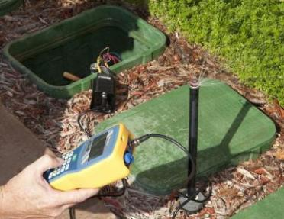
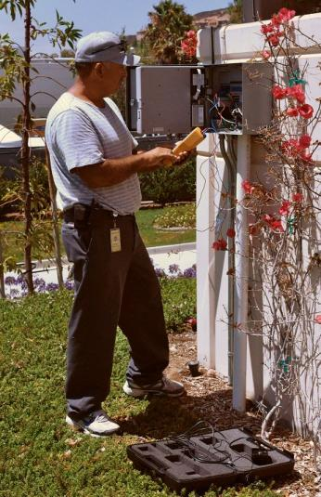
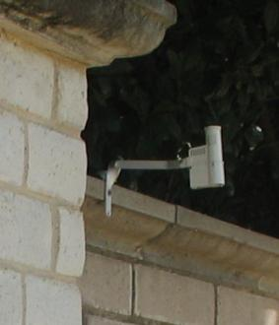
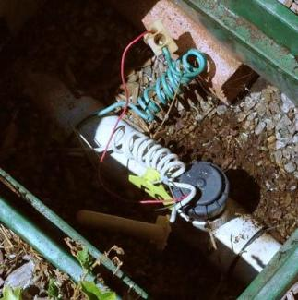
Use ICD-HP with:
Any Hunter Decoder
ALL Hunter ICD, DUAL and Pilot Series Decoders (new, or installed), including sensor decoders
Controller Sensor & Flow inputs
  ClikTM Simulator
  Flow Simulator
HFS Flow Meter outputs
Any ClikTM Sensor or switch closure output
Any Clik Sensor
HFS Flow Sensors

Slide 4
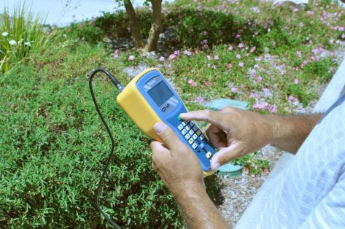
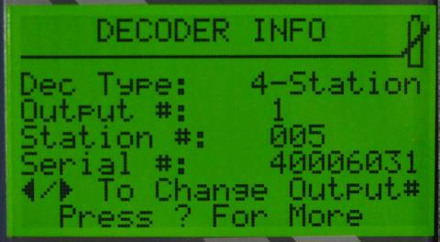
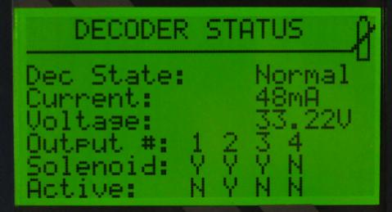
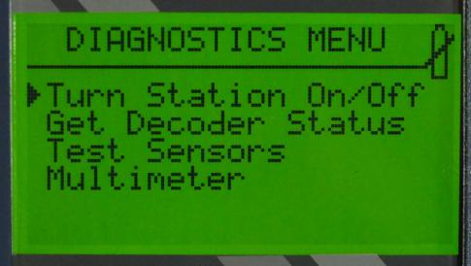
ICD-HP Function Overview
View decoder-Get Decoder Information from existing installations
solenoid status
Turn stations On and Off
View current draw in milliamps (both on, and off)
Flash update decoder firmware
Set Up and Test Sensor Decoders (ICD-SEN)
Test ClikTM Sensors
Program (and re-program) new, or existing, decoder station numbers
Test HFS Flow Sensors
Test ClikTM inputs to controller
Test Flow inputs to controller (Flow Simulator)
Measure two-wire path voltage

Slide 5

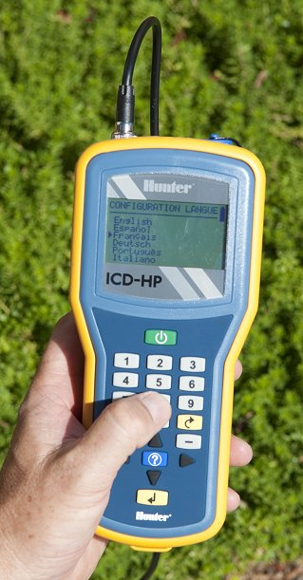
ICD-HP: The Decoder Professionals’ Friend
Wireless Programmer & Diagnostic Meter
Reduces Installation Time
Simplifies Diagnostics
Gets the Most Out of ICD Decoders!
  Program any stations in any order
  Allows blank decoder outputs for future expansion
Tests Sensors and Controllers, too!

Slide 6

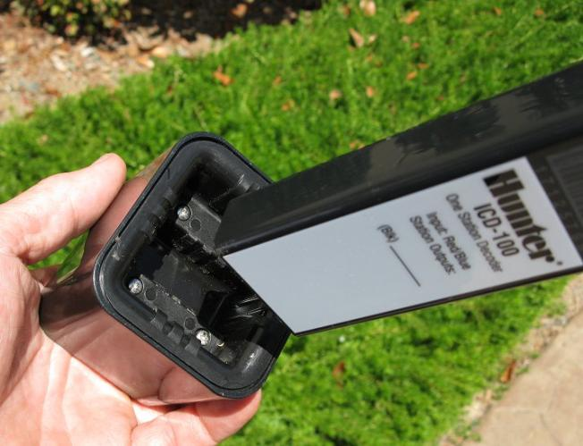
Wireless Decoder Connection
Waterproof Programming Cup (supplied with 6ft/2m cable)
Patented Wireless Induction Connection!
Communicates with ICD Decoder through bottom of module
  Other decoders do not have this feature!
Non-Radio-Based (wireless induction) with two-way decoder communications
Range: 1”/2.5cm (from edge of cup)
Designed to firmly grasp ICD decoders

Slide 7

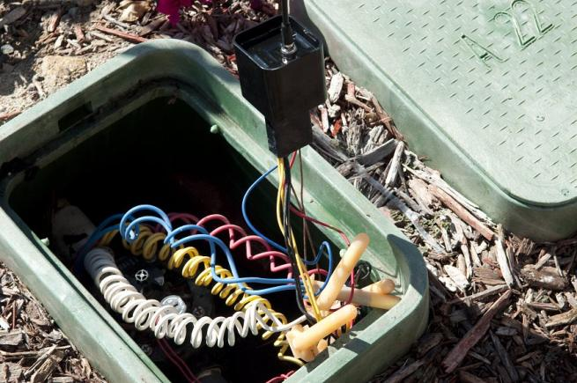
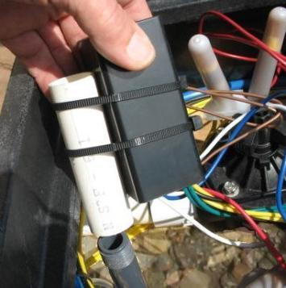
Wireless Decoder Connection
Communications without disconnection of field wires
No waste of waterproof connections
Check and operate solenoids through the decoder
Cup is waterproof, like decoders themselves
Hint: Stake decoder mounts in valve box bottom up, to ease access for programming cup

Slide 8
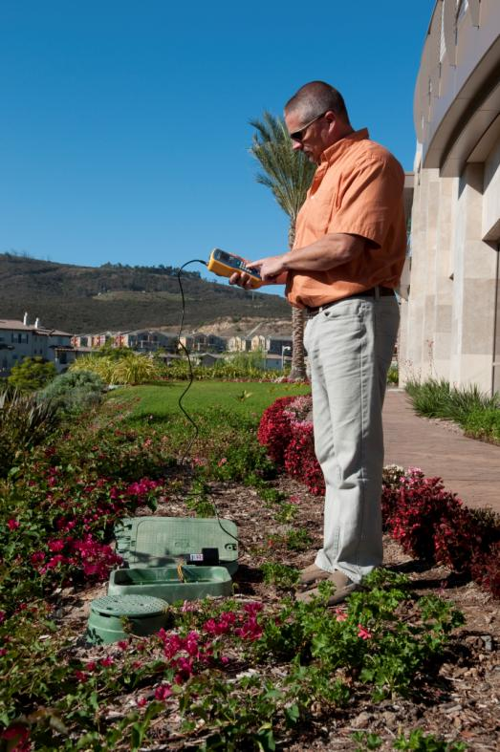
Wireless Decoder Connection
Allows all operations while standing (6ft/2m cable)
  Cable uses special reverse-polarity BNC connectors
Uses 4 x AA batteries in the field
  Batteries included
Keeps hands out of the valve box and reduces kneeling and crouching.

Slide 9
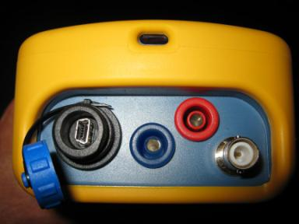
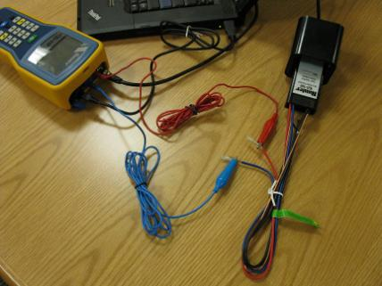
Bench Mode
Optional USB power input for office or bench use
  also works with some cell phone chargers*
Save batteries while programming stations in relative comfort
ICD-HP supplies power to new or disconnected decoders via red and blue leads (included)- then communicates through the cup
Mini-USB Power
Red/Blue lead jacks
Programming Cup connector
USB Power
Decoder Power from Red/Blue leads

Slide 10
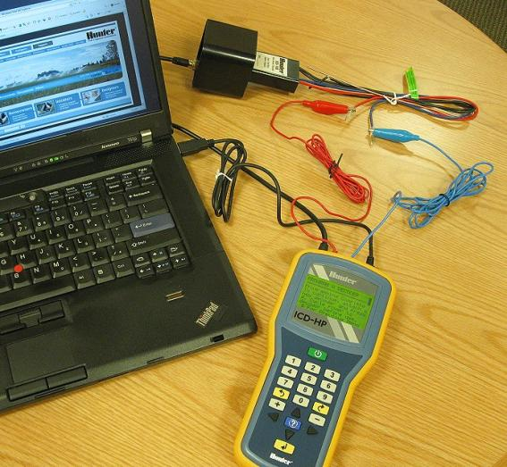
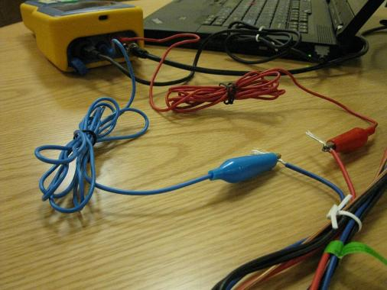
Bench Mode
Either PC or laptop can power ICD-HP
Connect decoder red and blue wires to ICD-HP leads
Insert decoder in programming cup, and program normally

Slide 11
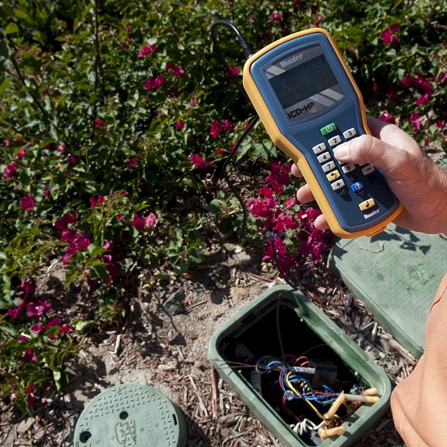
Programming Decoders: in-ground!
It is now possible to install decoders first, then program their station numbers in place.
Decoders must be connected to two-wire path, with controller powered on.
Attach programming cup, and program the decoder!

Slide 12
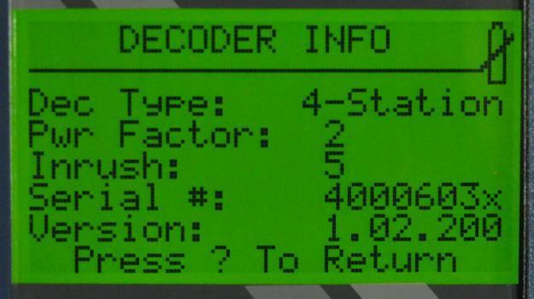
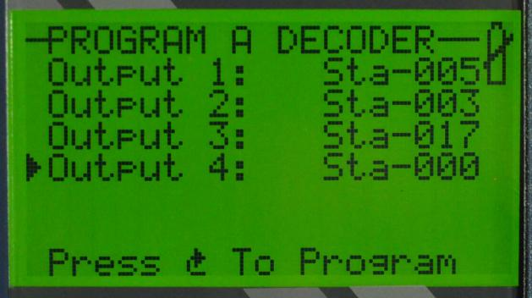
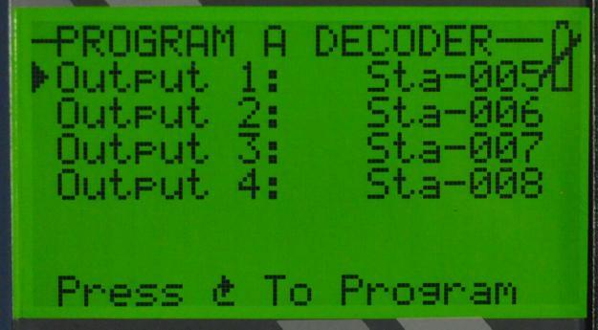
Programming Decoders
ICD-HP programs every option possible from the controller… and more!
View Power Factor and Inrush (and change if necessary)
View and Set Station Numbers (find accidental duplicate stations!)
View all outputs at once on multi-station decoders
Set any stations in any order!
Leave reserve stations at “000” for future use or expansion!

Slide 13

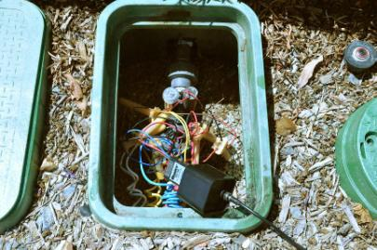
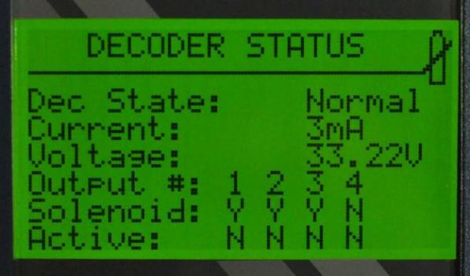
Diagnostics
View Decoder & Solenoid status at a glance
Shows current draw, in standby and when active
Line voltage at decoder (may require decoder firmware update)
Shows whether solenoids are present, and whether they are active (on/off)
  Can identify dead solenoids or bad connections, through the decoder
No Solenoid detected, output #4

Slide 14
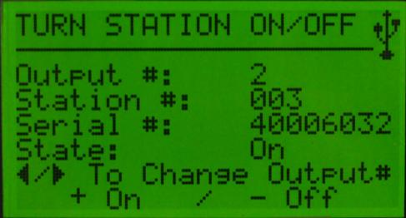
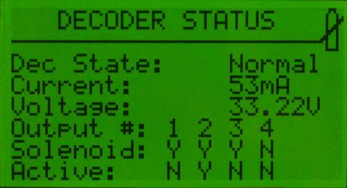

Diagnostics
Turn stations on from ICD-HP
Switch to Status to view solenoid activity
Remote Control (ICR, ROAM) can be used to activate Master Valve! This is a controller function that cannot be started from a station decoder.

Slide 15
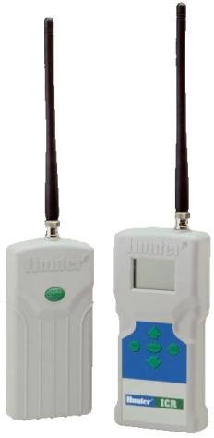
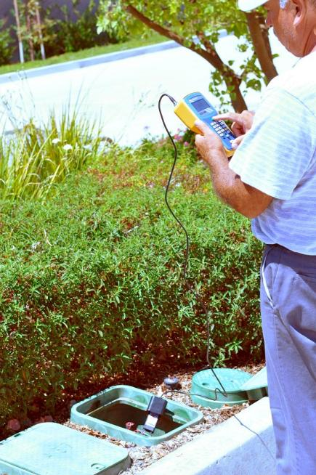
Perfect Companions: ICR or ROAM remotes
ICD-HP communicates with decoders.
ICR communicates with controllers.
Use ICR,ROAM or ROAM-XL to activate Pump/Master Valve (if necessary to charge line).
Use the remote to verify a newly programmed decoder

Slide 16

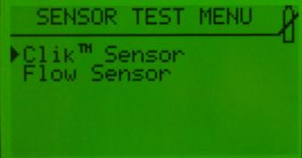
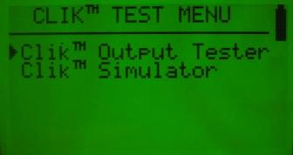
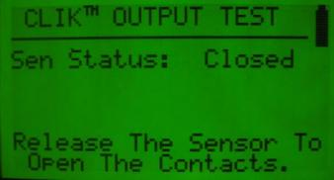
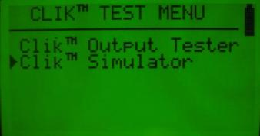
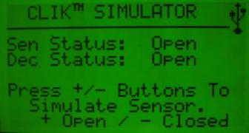
Diagnostics: ClikTM Sensors
Test ClikTM sensors, and ClikTM inputs
Test ICD-SEN sensor decoders, and controllers

Slide 17
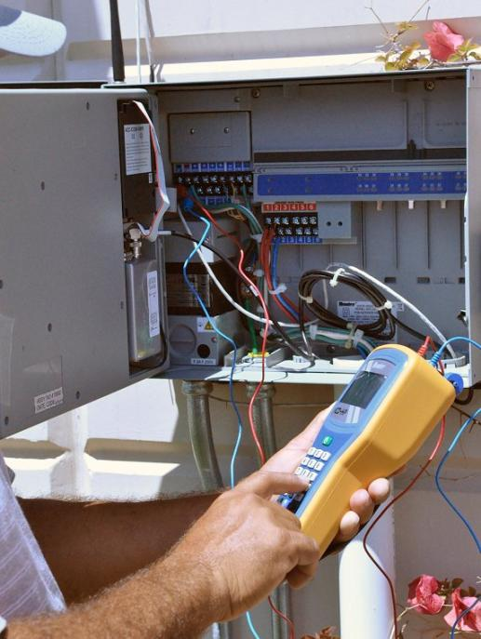
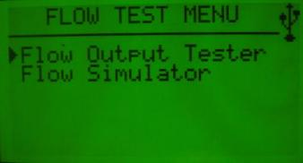
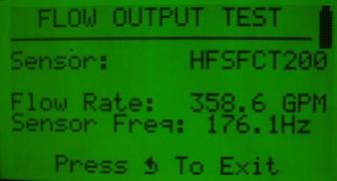
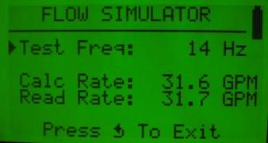
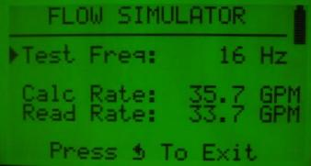
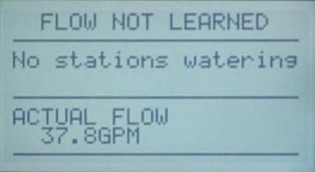
Diagnostics: Flow Sensors
Test Flow sensors, and Flow inputs
ICD-HP can read flow output from an HFS sensor directly, or through the ICD-SEN sensor decoder
ICD-HP can also create variable flow rate inputs to the controller

Slide 18
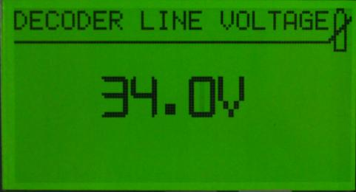
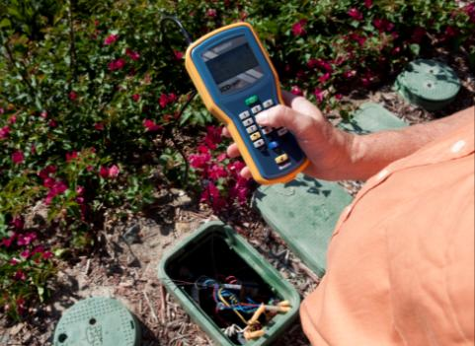
Diagnostics: Line Voltage
Connect the ICD-HP red and blue test leads to the two wire path at any point.
Read the line voltage (to verify adequate voltage for decoder operation).
Input is protected against accidental high voltage contact.

Slide 19
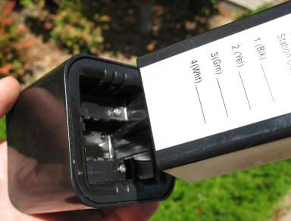
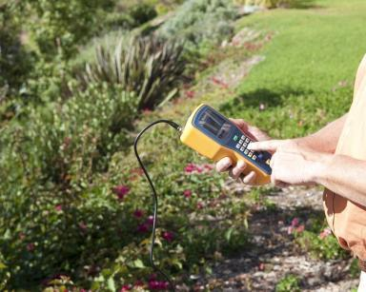
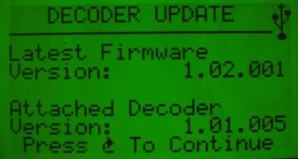
Decoder Updates
Checks existing decoder versions
Compares installed decoder version to the current version
Flash updates decoder in place to the very latest version (operator’s choice, 2.5 minutes per decoder)
No removal or reprogramming of installed decoder!

Slide 20
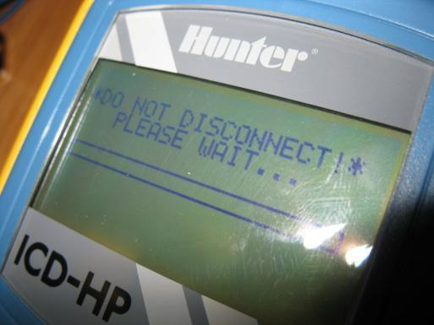
Flash Updates for the ICD-HP!
The ICD-HP itself can be flash-updated in the field
Free updates will be posted to the Hunter Industries web site
As new features become available for ICD-HP, they are FREE to existing owners!
Update from any PC or laptop

Slide 21

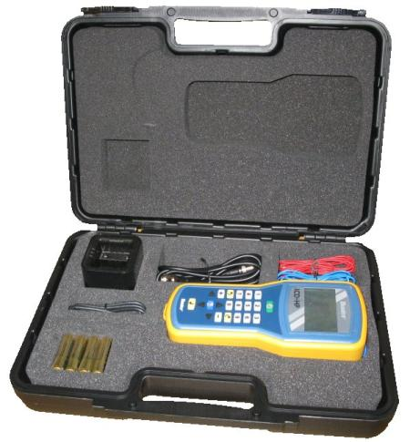
The Complete Package
Everything you need, no options to order!
Black plastic case with foam cutouts to keep accessories safe and dry
Includes:
  Wireless programming cup and 6ft/2m detachable cable
  Red and Blue test & power leads
  USB power cable
  4 x AA alkaline batteries
  Detailed Owner’s Manual

Slide 22

ICD Handheld Programmer

Slide 24

Thank You!

